Slide 1
Profiling And Optimisation in Python
Chris Cooling
Graduate School Teaching Fellow

Slide 2
Important Information on Marking your Attendance on Inkpath I will show you a QR code at the end of the session allowing you to mark your attendance on Inkpath. Please do not mark your attendance until then. If you are a Postgraduate Research student, this is required for receiving your Graduate School credit for this course.
Notes:
No additional notes.

Slide 3
Learning Outcomes
1. Determine when profiling and optimisation is appropriate for a project
2. Use selected profilers to examine the impact of section of code on run-time and memory usage
3. Utilise profiler outputs to identify problematic areas of code
4. Apply common optimisation techniques to improve code performance

Slide 4
Course Materials
The course materials are stored in a GitHub repository
Instructions for using the materials are found in the readme
Links to open the course notebooks in Colab are at the bottom of the readme
The materials can also be downloaded and run locally
You can also star/fork the repository

Slide 5
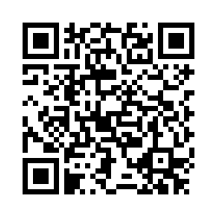
Feedback
Once you’ve completed this course, please provide feedback
The link is https://tinyurl.com/feedback-rcds
You should also have received an email with this link
This helps us improve the class for future students

Slide 6
Profiling and Optimisation in Python
Distributed under Creative Commons Attribution-NonCommercial-ShareAlike 4.0 International

